Slide 1
International Economic Relations ECON 308
Specific Factors and Income Distribution
(Chapter 4 Part 1)
Instructor: Muhebullah Karimzada
Notes:
If this PowerPoint presentation contains mathematical equations, you may need to check that your computer has the following installed:
1) MathType Plugin
2) Math Player (free versions available)
3) NVDA Reader (free versions available)

Slide 2
Learning Objectives
4.1 Understand how a mobile factor will respond to price changes by moving across sectors.
4.2 Explain why trade will generate both winners and losers in the short run.
4.3 Understand the meaning of gains from trade when there are losers.
4.4 Discuss the reasons why trade is a politically contentious issue.
4.5 Explain the arguments in favor of free trade despite the existence of losers.

Slide 3
Introduction
If trade is so good for the economy, why is there such opposition?
Two main reasons why international trade has strong effects on the distribution of income within a country:
Resources cannot move immediately or costlessly from one industry to another.
Industries differ in the factors of production they demand.

Slide 4
The Specific Factors Model (1 of 4)
The specific factors model allows trade to affect income distribution.
Assumptions of the model:
Two goods, cloth and food.
Three factors of production: labor (L), capital (K), and land (T for terrain).
Perfect competition prevails in all markets.

Slide 5
The Specific Factors Model (2 of 4)
Cloth produced using capital and labor (but not land).
Food produced using land and labor (but not capital).
Labor is a mobile factor that can move between sectors.
Land and capital are both specific factors used only in the production of one good.

Slide 6
The Specific Factors Model (3 of 4)
How much of each good does the economy produce?
The production function for cloth gives the quantity of cloth that can be produced given any input of capital and labor:
is the output of cloth
K is the capital stock
is the labor force employed in cloth

Slide 7
The Specific Factors Model (4 of 4)
The production function for food gives the quantity of food that can be produced given any input of land and labor:
is the output of food
T is the supply of land
is the labor force employed in food

Slide 8
Production Possibilities (1 of 6)
How does the economy’s mix of output change as labor is shifted from one sector to the other?
When labor moves from food to cloth, food production falls while output of cloth rises.

Slide 9
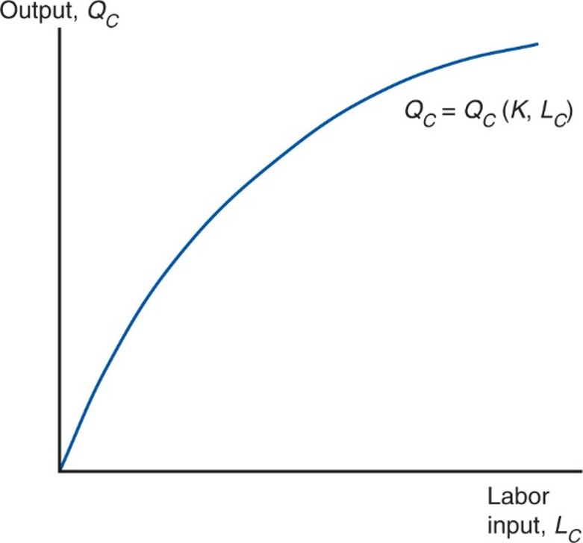
Figure 4.1 The Production Function for Cloth
The more labor employed in the production of cloth, the larger the output. As a result of diminishing returns, however, each successive person-hour increases output by less than the previous one; this is shown by the fact that the curve relating labor input to output gets flatter at higher levels of employment.

Slide 10
Production Possibilities (2 of 6)
The shape of the production function reflects the law of diminishing marginal returns.
Adding one worker to the production process (without increasing the amount of capital) means that each worker has less capital to work with.
Therefore, each additional unit of labor adds less output than the last.
Figure 4.2 shows the marginal product of labor, which is the increase in output that corresponds to an extra unit of labor.

Slide 11
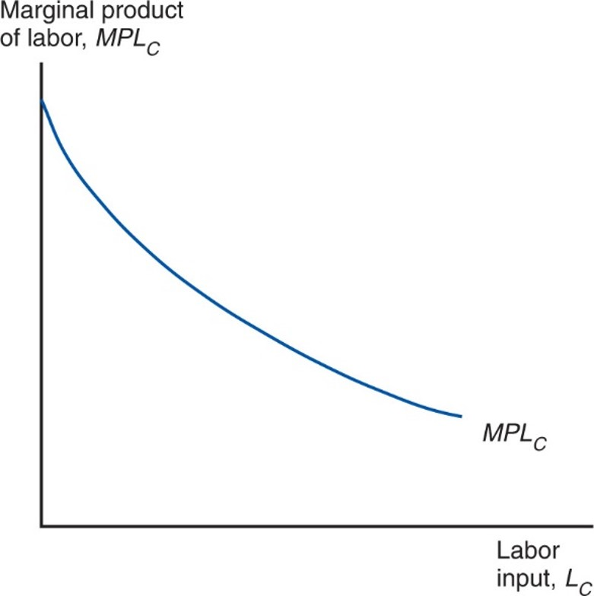
Figure 4.2 The Marginal Product of Labor
The marginal product of labor in the cloth sector, equal to the slope of the production function shown in Figure 4.1, is lower the more labor the sector employs.

Slide 12
Production Possibilities (3 of 6)
For the economy as a whole, the total labor employed in cloth and food must equal the total labor supply:
Use these equations to derive the production possibilities frontier of the economy.

Slide 13
Production Possibilities (4 of 6)
Use a four-quadrant diagram to construct production possibilities frontier in Figure 4.3.
Lower left quadrant indicates the allocation of labor.
Lower right quadrant shows the production function for cloth from Figure 4.1.
Upper left quadrant shows the corresponding production function for food.
Upper right quadrant indicates the combinations of cloth and food that can be produced.

Slide 14
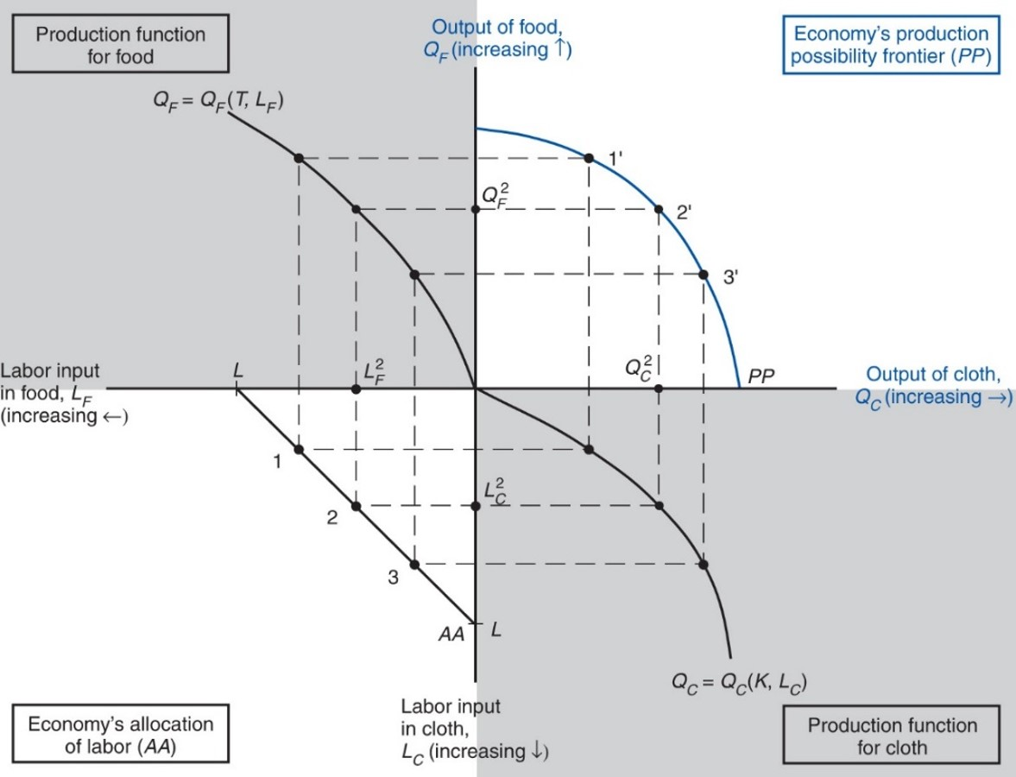
Figure 4.3 The Production Possibility Frontier in the Specific Factors Model
P P in the upper-right quadrant shows the economy’s production possibilities for given supplies of land, labor, and capital. Due to diminishing returns, P P is a bowed-out curve instead of a straight line.
Notes:
The origin of the graph is the intersection of the labor input in food and the output of cloth, on the x-axis, versus the output of food down to the labor input in cloth, on the y-axis. The upper left quadrant is production function of food, Q sub F = Q sub F (T, L sub F). The y-axis is the output of food, Q sub F, which increases upward from the origin, versus the labor input of food, L sub F, which increases leftward from the origin. The plot rises to the left with decreasing steepness from the origin through 3 points. The upper right quadrant is the economy’s production possibility frontier, P P; the y-axis is output of food, Q sub F, which increase upward from the origin, and the x-axis is output of cloth, Q sub C, which increases rightward from the origin. The plot falls with increasing steepness from the y-axis to the x-axis through 3 points, 1 prime, 2 prime, and 3 prime. The lower left quadrant is the economy’s allocation of labor, A A. It has an upper x-axis of labor input of food, L sub F, which increases leftward from the origin, and a y-axis at the right for labor input in cloth, L sub C., which increases downward from the origin. The plot is a straight line that extends downward from point L on the x-axis to point L on the y-axis, through points 1, 2, and 3. The lower right quadrant is the production function for cloth, Q sub C = Q sub C, left parenthesis K comma L sub C right parenthesis. The quadrant has an upper x-axis of output of cloth, Q sub C, which increases rightward from the origin, and a y-axis at the left for labor input in cloth, L sub C, which increases downward from the origin. The plot falls from the origin with increasing steepness through 3 points. Additional points are placed on each axis as follows: L squared sub F, on the axis for L sub F where A A = 2; Q squared sub F, on the Q sub F axis where P P = 2 prime; Q squared sub C, on the Q sub C axis where P P = 2 prime; and L squared sub C, on the L sub C axis where A A = 2.

Slide 15
Production Possibilities (5 of 6)
Why is the production possibilities frontier curved?
Diminishing returns to labor in each sector cause the opportunity cost to rise when an economy produces more of a good.
Opportunity cost of cloth in terms of food is the slope of the production possibilities frontier—the slope becomes steeper as an economy produces more cloth.

Slide 16
Production Possibilities (6 of 6)
Opportunity cost of producing one more yard of cloth is
pounds of food.
To produce one more yard of cloth, you need
hours of labor.
To free up one hour of labor, you must reduce output of food by
pounds.
To produce less food and more cloth, employ less in food and more in cloth.
The marginal product of labor in food rises and the marginal product of
labor in cloth falls, so
rises.

Slide 17
Prices, Wages, and Labor Allocation (1 of 10)
How much labor is employed in each sector?
Need to look at supply and demand in the labor market.
Demand for labor:
In each sector, employers will maximize profits by demanding labor up to the point where the value produced by an additional hour equals the marginal cost of employing a worker for that hour.

Slide 18
Prices, Wages, and Labor Allocation (2 of 10)
The demand curve for labor in the cloth sector:
The wage equals the value of the marginal product of labor in manufacturing.
The demand curve for labor in the food sector:
The wage equals the value of the marginal product of labor in food.

Slide 19
Prices, Wages, and Labor Allocation (3 of 10)
Figure 4.4 represents labor demand in the two sectors.
The demand for labor in the cloth sector is
from Figure 4.2 multiplied by
The demand for labor in the food sector is measured from the right.
The horizontal axis represents the total labor supply L.

Slide 20
Prices, Wages, and Labor Allocation (4 of 10)
The two sectors must pay the same wage because labor can move between sectors.
If the wage were higher in the cloth sector, workers would move from making food to making cloth until the wages become equal.
Or if the wage were higher in the food sector, workers would move in the other direction.
Where the labor demand curves intersect gives the equilibrium wage and allocation of labor between the two sectors.

Slide 21
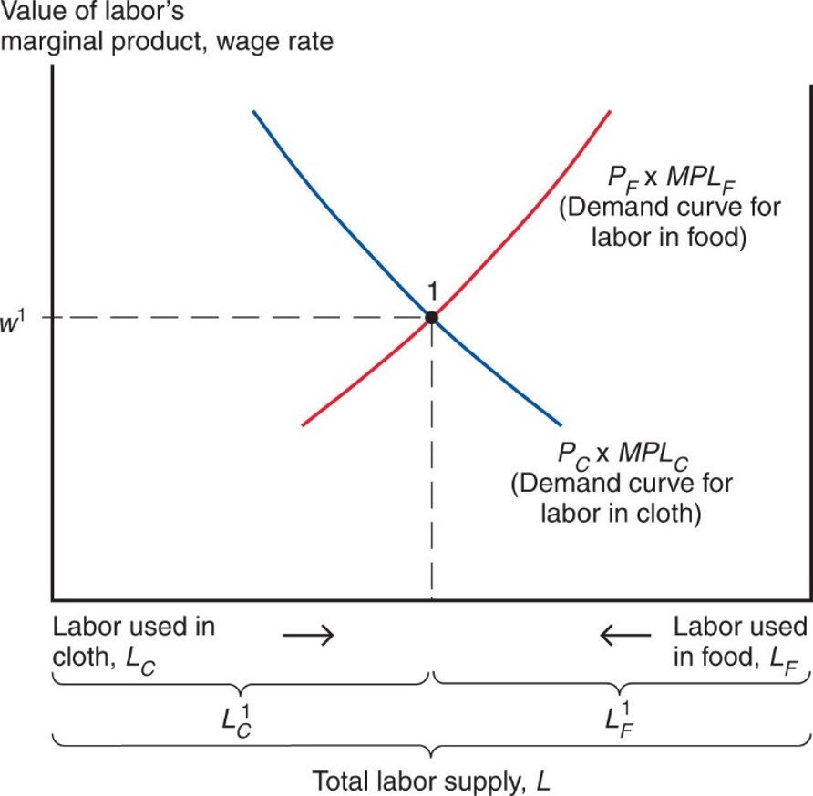
Figure 4.4 The Allocation of Labor
Labor is allocated so that the value of its marginal product
is the same in the cloth and food sectors. In equilibrium, the wage rate is equal to the value of labor’s marginal product.
Notes:
The total labor supply is divided into two equal parts, labor used in cloth or L sub C, and labor used in food or L sub F. These parts are labeled L super 1 sub C, on the left, and L super 1 sub F, on the right, and decrease toward the center of the x-axis, increasing outward in opposite directions. The demand curve for labor in cloth, P sub C times M P L sub C, falls with decreasing steepness from left to right. The demand curve for labor in food, P sub F times M P L sub F, rises with increasing steepness from left to right. The two curves intersect at point 1, where y = w super 1, and the labor used in cloth is equal to the labor used in food.

Slide 22
Prices, Wages, and Labor Allocation (5 of 10)
At the production point, the production possibility frontier must be tangent to a line whose slope is minus the price of cloth divided by that of food.
Relationship between relative prices and output:

Slide 23
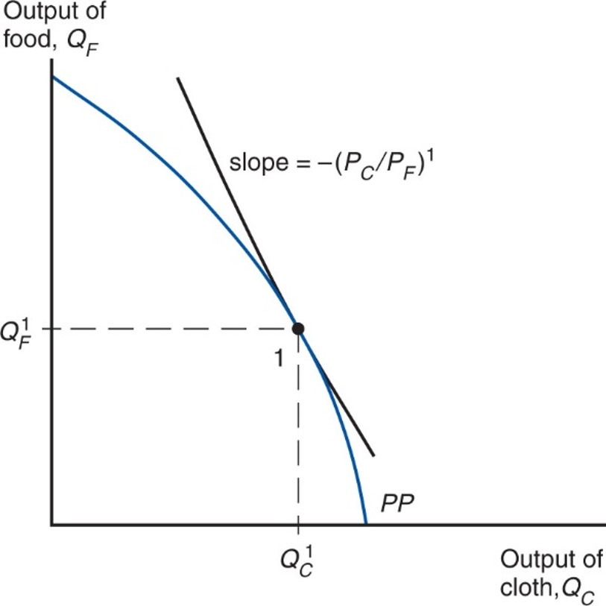
Figure 4.5 Production in the Specific Factors Model
The economy produces at the point on its production possibility frontier (P P) where the slope of that frontier equals minus the relative price of cloth.
Notes:
The plot falls with increasing steepness from y-axis to x-axis. The slope = negative, left parenthesis, P sub C, over P sub F, right parenthesis, super 1, where y = Q super 1 sub F and x = Q super 1 sub F, which intersect at point 1 on the curve.

Slide 24
Prices, Wages, and Labor Allocation (6 of 10)
What happens to the allocation of labor and the distribution of income when the prices of food and cloth change?
Two cases:
An equal proportional change in prices
A change in relative prices

Slide 25
Prices, Wages, and Labor Allocation (7 of 10)
When both prices change in the same proportion, no real changes occur.
The wage rate (w) rises in the same proportion as the prices, so real wages (i.e., the ratios of the wage rate to the prices of goods) are unaffected.
The real incomes of capital owners and landowners also remain the same.

Slide 26
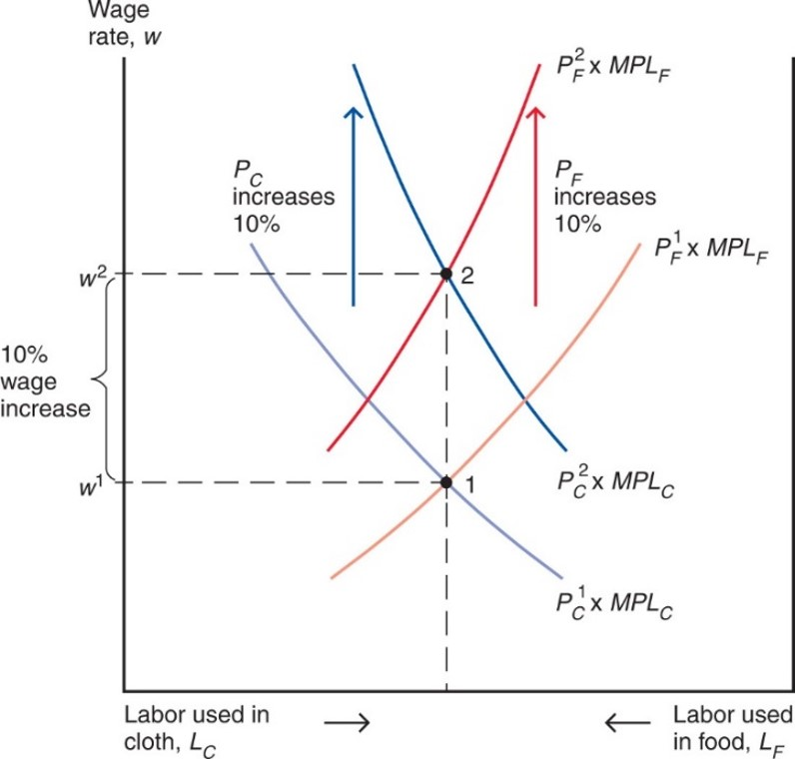
Figure 4.6 An Equal-Proportional Increase in the Prices of Cloth and Food
The labor demand curves in cloth and food both shift up in proportion to
the rise in
and the rise in
The wage rate rises in the same proportion, from
but the allocation of labor between the two sectors does not change.
Notes:
The graph shows wage rate versus labor supply, which is divided into 2 equal parts, labor used in cloth or L sub C, and labor used in food or L sub F. Labor used in cloth increases to the left and labor used in food increases to the right. The plot for P sub C super 1 times M P L sub C falls with decreasing steepness from left to right. The plot for P sub F super 1 times M P L sub F rises from left to right with increasing steepness. The two plots intersect at point 1, where y = w 1. With a 10% wage increase to y = W super 2, both the P sub C and P sub F increase by 10%; the plots also rise or fall with greater steepness. The plot for P sub C super 2 times M P L sub C falls from left to right with decreasing steepness, and the plot for P sub F super 2 times M P L sub F rises with increasing steepness. The plots intersect at point 2, where y = w super 2, at the same x-value as point 1.

Slide 27
Prices, Wages, and Labor Allocation (8 of 10)
When only
rises, labor shifts from the food sector
to the cloth sector and the output of cloth rises while that of food falls.
The wage rate (w) does not rise as much as
since
cloth employment increases and thus the marginal product of labor in that sector falls.

Slide 28
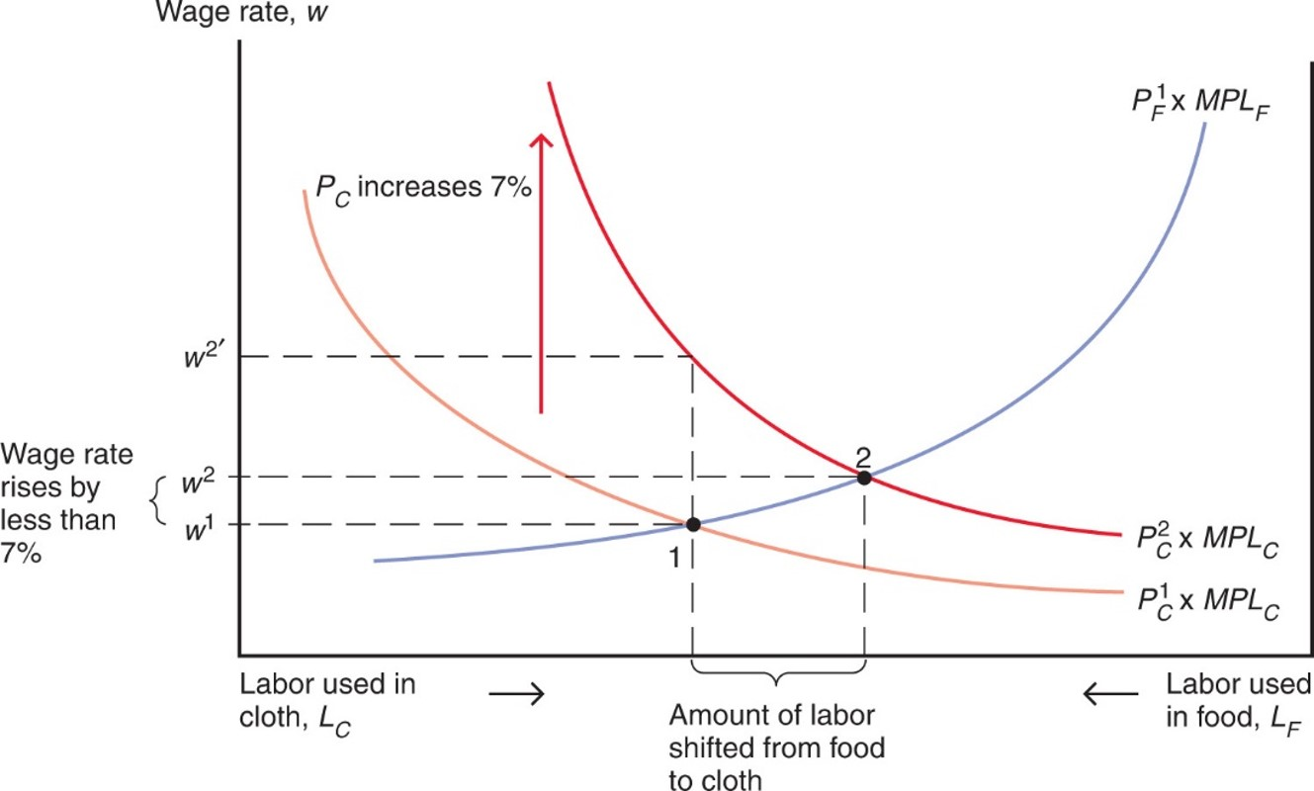
Figure 4.7 A Rise in the Price of Cloth
The cloth labor demand curve rises in proportion to the 7 percent
increase in
but the wage rate rises less than proportionately.
Labor moves from the food sector to the cloth sector. Output of cloth rises; output of food falls.
Notes:
Labor used in cloth increases to the left and labor used in food increases to the right. Horizontal lines are drawn at y = w super 1, and y = w super 2, which indicated a wage rate rise by less than 7%. A dotted line at y = w super 2 prime indicates is above y = W super 2. The plot for P sub F super 1 times M P L sub F rises with increasing steepness through point 1, where y = w super 1, and through point 2, where y = w super 2. The plot for P sub C super 1 times M P L sub C falls with decreasing steepness through point 1, where y = w 1. With a P sub C increase of 7%, the plot for P sub C super 2 times M P L sub C falls with decreasing steepness through point 2, where y = w super 2. The dotted line for y = w super 2 intersected this plot in line with point 1 on the x-axis. Point 2 is shifted to the right of point 1.

Slide 29
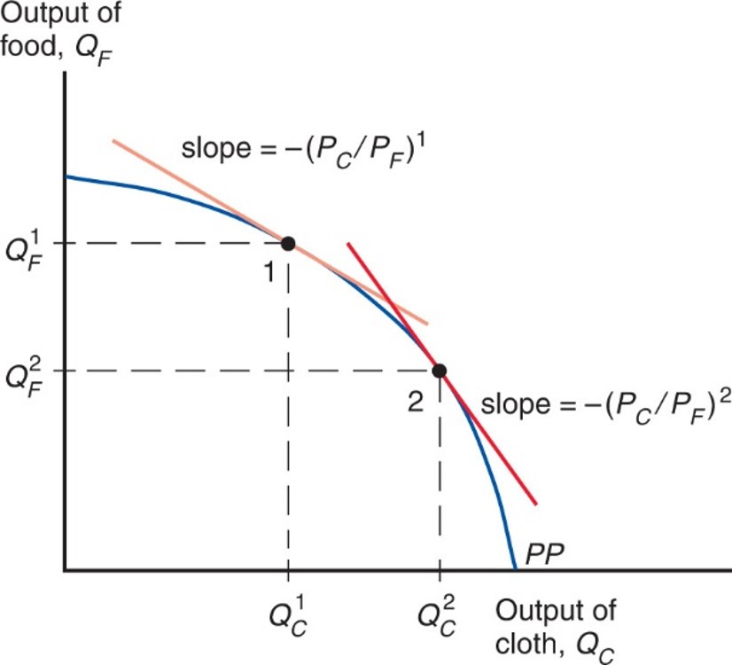
Figure 4.8 The Response of Output to a Change in the Relative Price of Cloth
The economy always produces at the point on its production possibility frontier (P P) where the slope of P P equals minus the relative price of
cloth. Thus, an increase in
causes production to move down
and to the right along the production possibility frontier corresponding to higher output of cloth and lower output of food.
Notes:
The plot for P P falls with increasing steepness from the y-axis to the x-axis, through points 1 and 2. At point 1, where y = Q sub F super 1 and x = Q sub C super 1, the plot = negative, left parenthesis, P sub C over P sub F, right parenthesis, super 1. At point 2, where y = Q sub F super 2 and x = Q sub C super 2, the slope is more steep, labeled as negative, left parenthesis, P sub C over P sub F, right parenthesis, super 2.

Slide 30
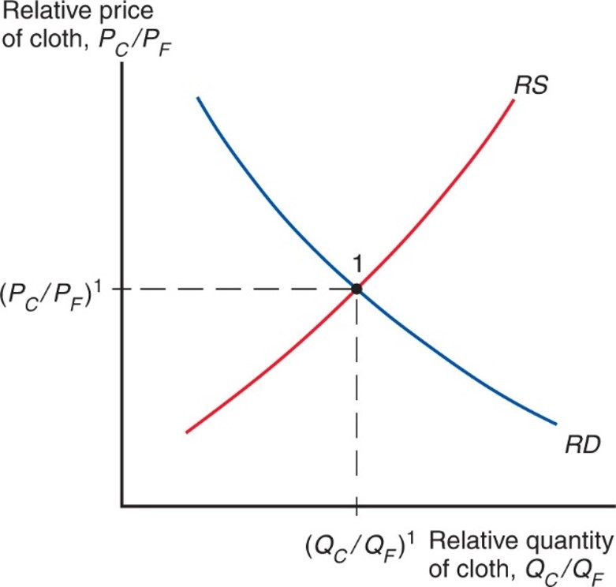
Figure 4.9 Determination of Relative Prices
In the specific factors model, a higher relative price of cloth will lead to an increase in the output of cloth relative to that of food. Thus, the relative supply curve R S is upward sloping. Equilibrium relative quantities and prices are determined by the intersection of R S with the relative demand curve R D.
Notes:
The R S curve rises with increasing steepness and intersects the R D curve, which falls with decreasing steepness. Their intersection is the equilibrium, point 1. At point 1, y = P sub C over P sub F, super 1, and x = Q sub C over Q sub F, super 1.

Slide 31
Prices, Wages, and Labor Allocation (9 of 10)
Relative Prices and the Distribution of Income
Suppose that
increases by 10%. Then, the
wage would rise by less than 10%.
What is the economic effect of this price increase on the incomes of the following three groups?
Workers, owners of capital, and owners of land

Slide 32
Prices, Wages, and Labor Allocation (10 of 10)
Owners of capital are definitely better off.
Landowners are definitely worse off.
Workers: cannot say whether workers are better or worse off:
Depends on the relative importance of cloth and food in workers’ consumption.

